Slide 1
Ground-truthing Obituaries

Slide 2
Project Overview
Untapped sources
Obituaries: hundreds of millions
Problem: how to cost-effectively extract
Extraction tools
Read and do form-fill type-in
Form-fill by clicking
Copy/paste & correction
Genealogy construction by inference
Synergistic
Automated form-fill with user correction
Automated information repository search with patron correction
Ground truthing
Notes:
Explain: we are “Groundtruthing” – you will be asked to extract same name extracted multiple times. Don’t worry about it and realize that you are helping with research of underlying extraction tools, not experimenting with expected form types for patrons.

Slide 3
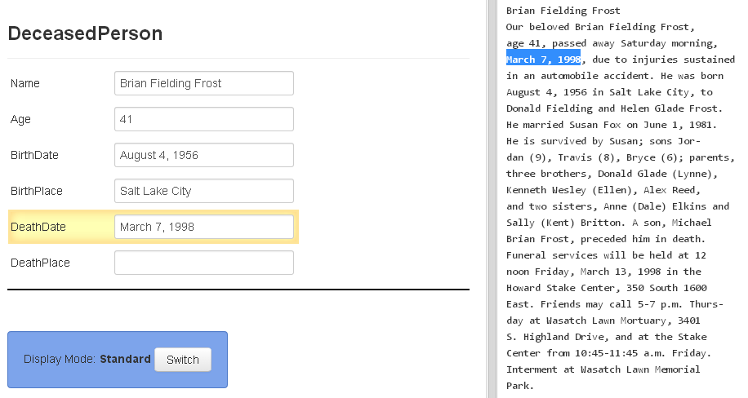
Form-fill: Click-only

Slide 4
Synergistic: Automatic Form-fill with Human Confirmation/Correction
√
Notes:
We are also interested in how easy it is to do the task and how accurately the process of groundtruthing is, because we’ll need to make decisions about who/what will do what and when, …

Slide 5
Demo
Basic functionality—enough so that the following rules and hints will make sense.

Slide 6
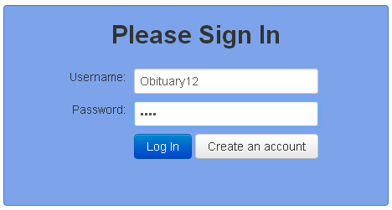
The Annotator Interface
Navigate to “dithers.cs.byu.edu/ObitAnnotator” and login:
You will be given several username-password pairs. Each is associated with a batch of obituaries to process.
Select obituary to annotate:
When you have finished all obituaries in the batch and have saved your work, you need do nothing more. To start another batch, navigate to “dithers.cs.byu.edu/ObitAnnotator”
Obituaries to Annotate
Obituary 1
Obituary 2
Obituary 3
Save work and continue to next obituary:

Slide 7
Best-Practice Hints
Use click, Alt-click, or mouse-drag-and-click only (to the extent possible).
Hold down Ctrl to add tokens to a field. (Sometimes a click doesn’t “take”; just click again.)
To remove a character that should be omitted, click on the character and use Backspace/Delete, and then Esc when done.
The field focus changes automatically; use Tab and shift-Tab to manually go forward and backward through the fields.
A blank record or field at the end need not be deleted.
Be familiar with Actions and use Keyboard Shortcuts.
Notes:
Put the real Keyboard Shortcuts in place of this old one.
Instead of Ctrl, use Command on a MAC.

Slide 8
Best-Practice Hints
Use click or mouse-drag-and-click only (to the extent possible).
Hold down Ctrl to add tokens to a field. (Sometimes a click doesn’t “take”; just click again.)
To remove a character that should be omitted, click on the character and use Backspace/Delete, and then Esc when done.
The field focus changes automatically; use Tab and shift-Tab to manually go forward and backward through the fields.
A blank record or field at the end need not be deleted.
Be familiar with Actions and use Keyboard Shortcuts.
Notes:
Put the real Keyboard Shortcuts in place of this old one: OK for now, but will likely add selection lists.
Instead of Ctrl, use Command on a MAC.

Slide 9
General Rules
Record only typeset information (nothing written by hand).
Do not fix errors (misspellings, typesetting, typos, OCR, …).
Restore “real” end-of-line hyphens.
Notes:
Put the real Keyboard Shortcuts in place of this old one.
Instead of Ctrl, use Command on a MAC.

Slide 10
Rules for Person Names
Extract a name for each person mentioned, exactly as it appears, including any punctuation, titles, parentheses, quote marks, and suffixes. (Don’t add inferred name parts, such as maiden names or surnames, when they don’t actually appear in the name, as written.)
If more than one name appears for a person, select only the most complete name—the first if several complete names appear.
For “names” that designate more than one person, record the name for each person.

Slide 11
Examples for Person Name Rules
Brian Fielding Frost
Our beloved Brian Fielding Frost,
age 41, passed away Saturday morning,
March 7, 1998, due to injuries sustained
in an automobile accident. He was born
August 4, 1956 in Salt Lake City, to
Donald Fielding and Helen Glade Frost.
He married Susan Fox on June 1, 1981.
He is survived by Susan; sons Jor-
dan (9), Travis (8), Bryce (6); parents,
three brothers, Donald Glade (Lynne),
Kenneth Wesley (Ellen), Alex Reed,
and two sisters, Anne (Dale) Elkins and
Sally (Kent) Britton. A son, Michael
Brian Frost, preceded him in death.
Funeral services will be held at 12
noon Friday, March 13, 1998 in the
Howard Stake Center, 350 South 1600
East (Bishop Lynn Jones, presiding).
Friends may call 5-7 p.m. Thursday at
Wasatch Lawn Mortuary, 3401 South
Highland Drive, and at the Stake
Center from 10:45-11:45 a.m. Friday.
Record the name exactly as it appears (don’t add the inferred surname “Frost”)
Record only the first full name
Record as: “Jordan”.* Hint: Alt-click on “Jor-” does this automatically.
Record the more complete name
Record the name exactly as it appears (just “Sally” —don’t add either the married name “Britton” or the maiden name “Frost”)
Record names exactly as they appear, including the parentheses (don’t add the married name “Frost”)
*Record “Susan Smith-
Jones” as:
“Susan Smith-Jones”. Hint:
Hold Ctrl click “Smith”, click “-”, click “Jones”.
Include titles
Notes:
For ground-truthing, we’ll want to strictly follow the rules, so we can be confident in the metrics.
BUT for actual use: (1) The rules can be looser – it shouldn’t matter if they pick up extra name components (like the surname of the father or the maiden name or married name of the married sisters). (2) The arbitrator probably ought to be checking the inferred information – parent/child, marriages, genders, full names, …

Slide 12
Examples of Possible Name Appearances and What to Do
Two persons in one name: extract “Mrs. John A. Smith” as “Mrs. John A. Smith”
and “John A. Smith” (and indicate a spousal relationship as well). For “Mr. and Mrs.
John A. Smith” extract “Mr. John A. Smith” and “Mrs. John A. Smith”.
Two person names bound together: extract “Nancy Smith (Jim)” as “Nancy Smith” and
“(Jim)” (include the parentheses, don’t include the surname “Smith” for “(Jim)”).
And for “Nancy (Jim) Smith” extract “Nancy” and “(Jim) Smith”.
Unusually long names: “María de la Cruz Juana Gómez Velásquez vda. De Gutiérrez”
(record all of it)
Multiple titles: “Prof. Dr. Hans Schwartz” (include both titles and the punctuation as well)
Nicknames: “Bernard Larsen (Bud)” or “Bernard ‘Bud’ Larsen” (include the
punctuation—the parentheses and the single quote marks)
Non-names if they designate a person not otherwise named: “Baby Boy” in the phrase
“survived by an as-yet-unborn Baby Boy”

Slide 13
Rules for Relationships
Record a relationship to the deceased person (when stated) for every related person named in the obituary. Leave the relationship field blank for non-familial relationships, such as “friend” or “presiding reverend.”
Record the relationship that coincides with the chosen name when a person’s name appears more than once. (For “sons John, James, …” and later “pallbearers John, James, …”, record “son” for both John and James.)
Select a radio button for “Spouse,” “Ancestor,” “Sibling,” “Descendant,” and “Other,” and then select a more specific relationship if stated in the obituary. Hint: immediately selecting a more specific relationship automatically selects the radio button.
Record the spouse name of a relative when the spouse name appears with the name of a sibling, descendant, or other relative. (For “survived by a sister Nancy (Jim) Smith, record “Nancy” as a “sister” and “(Jim) Smith” in the SiblingSpouseName associated with Nancy.)

Slide 14
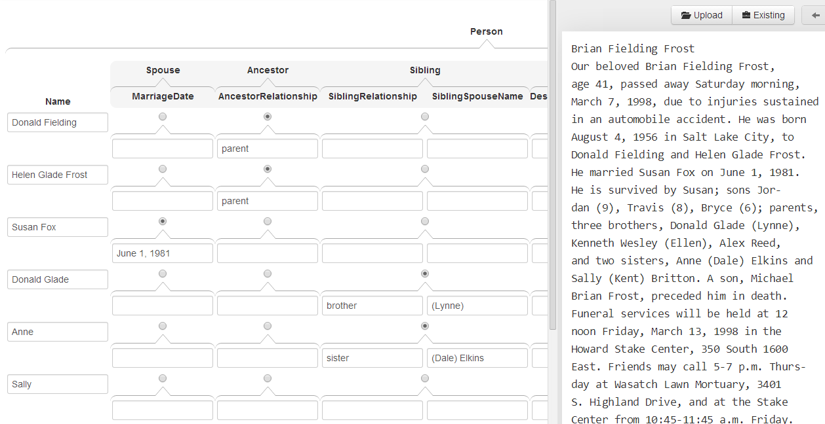
Relationship Specification
“father” not stated; “born … to”, “parent”s, stated
sibling
brother
sister
Hint: Names need not be recorded in order, although it may be convenient to do so.

Slide 15
Rules for Dates
Record dates as they appear, including punctuation.
If more than one birth or death date appears, record only one—the most complete or the first.
In the absence of actual birth or death dates, record given date indicators.
Record the age at the time of death, if given.

Slide 16
Examples for Date Rules
For “born about 1738”, record “about 1738”
For “died last Friday, Nov. 4, 1898.”, record “Nov. 4, 1898” (including the abbreviation period and the comma, but not the terminating period)
For “died last Friday, Nov. 4.”, record “Nov. 4” (the year will be known from the obituary posting date)
For “died on Friday.”, record “Friday”
For “died Friday, the week before last.”, record “Friday, the week before last”.
For “died in combat in November of last year.”, record “November of last year”.
For “died on Valentine’s Day”, record “Valentine’s Day”
Principle: record the information that will allow the system to get the best possible date.

Slide 17
Rules for Place Names
Record place names as they appear, including punctuation.
In the absence of an actual birth or death places, record given place indicators.

Slide 18
Examples for Place Names
For “died in Springfield, Illinois.”, record “Springfield, Illinois” (including the comma)
For “died in Springfield.”, record “Springfield” (knowing the local of the posted obituary, the system can complete the place name)
For “died near Springfield.”, record “near Springfield”
For “died at his home.”, record “his home”
For “died at Mercy Hospital.”, record “Mercy Hospital”
For “wounded in the Battle of the Bulge and died later in an army hospital” record nothing—don’t infer places.
Principle: if available, record the information that will allow the system to get the best possible place.

Slide 19
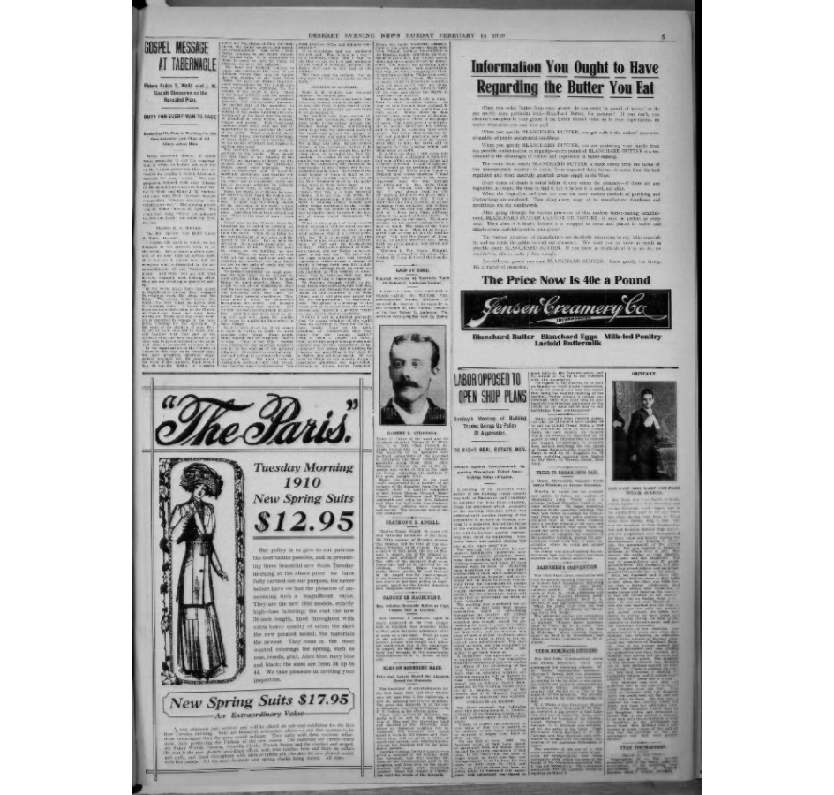
Good Luck!

